Slide 1
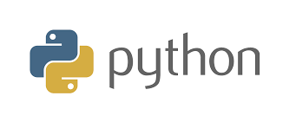
BASICS OF PYTHON

Slide 2
CONTENTS
Introduction to Python
Programming Language vs Scripting Language
Features of Python
Advantages of Python
Applications of Python
Installing Python IDE
Python Data Types

Slide 3
INTRODUCTION TO PYTHON
Python is a simple, general purpose, high level, and object-oriented programming language.
Python is a Scripting Language. Guido Van Rossum is the founder of Python Programming.
Python is a General Purpose, Dynamic, High-Level, and interpreter based Programming Language.
It supports Object Oriented Programming Approach to Develop Applications. It is simple and easy to learn and provides lots of high-level data structures.

Slide 4
PROGRAMMING LANGUAGE VS SCRIPTING LANGUAGE
Programming Language | Scripting Language
It’s a Compiler based Language | It’s an Interpreter based Language
They run Independent of a Parent Program | They run Inside Another Program
Designed to give full usage of Language | Designed to make Coding Fast and Simple
One Shot Conversion | Line by Line Conversion
It Creates a .exe file | It does not Create a .exe file
Program Compilation is Necessary | Program Compilation is not Necessary

Slide 5
FEATURES OF PYTHON
Easy to code
Free and Open Source
Object-Oriented Language
High-Level Language
Python is Integrated language
Interpreted Language
Large Standard Library
Dynamically Typed Language

Slide 6
ADVANTAGES OF PYTHON
1. Presence of third-party modules
2. Extensive support libraries(NumPy for numerical calculations, Pandas for data analytics)
3. Open source and community development
4. Easy to learn
5. User-friendly data structures
6. High-level language
7. Dynamically typed language(No need to mention data type based on value assigned, it takes data type)
8. Object-oriented language
9. Portable and Interactive
10. Portable across Operating systems

Slide 7
APPLICATIONS
1. GUI based desktop applications (Games, Scientific Applications)
2. Web frameworks and applications
3. Enterprise and Business applications
4. Operating Systems
5. Language Development
6. Prototyping

Slide 8
INSTALLING PYTHON
Steps to Install Python IDLE:
Go to http://www.python.org/downloads/
Download the Latest Version for Windows
Double Click on that .exe file
Click on the Install Option
Click on Finish Button
Steps to Install PYCHARM IDE:
Go to http://www.jetbrains.com/pycharm/download
Python must be Installed before Pycharm Installation
Install any Edition Community or Professional

Slide 9
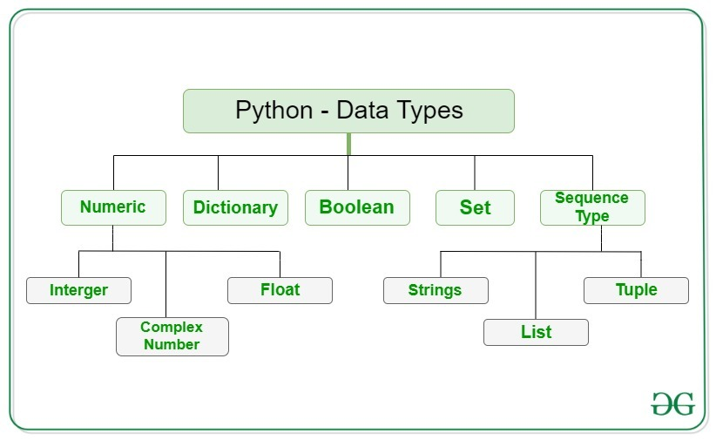
PYTHON DATA TYPES

Slide 10
NUMERIC DATA TYPES
In Python, Numeric Data Type represent the data which has Numeric Value.
Numeric value can be integer, floating number or even complex numbers.
These values are defined as int, float and complex class in Python.
Integers – This value is represented by int class. It contains positive or negative whole numbers
Float – This value is represented by float class. It is a real number with floating point representation. It is specified by a decimal point.
Complex Numbers – Complex number is represented by complex class. It is specified as (real part) + (imaginary part).

Slide 11
PYTHON PROGRAM TO DEMONSTRATE NUMERIC VALUE
INPUT:
a = 5
print("Type of a: ", type(a))
b = 5.0
print("Type of b: ", type(b))
c = 2 + 4j
print("Type of c: ", type(c))
OUTPUT:
Type of a: <class 'int'>
Type of b: <class 'float'>
Type of c: <class 'complex'>

Slide 12
SEQUENCE DATA TYPES
1. String
A string is a collection of one or more characters put in a single quote, double-quote or triple quote. It is represented by str class.
2. List
A single list may contain Data Types like Integers, Strings, as well as Objects. Lists are mutable. List in Python are ordered and have a definite count. It is represented by list class. Lists in Python can be created by just placing the sequence inside the square brackets[].
3. Tuple
Tuple is an ordered collection of Python objects much like a list. The sequence of values stored in a tuple can be of any type. The difference between a list and a tuple is that tuples are immutable. It is represented by tuple class.

Slide 13
PYTHON PROGRAM FOR CREATION OF STRING
INPUT:
String1 = 'Welcome to the World'
print("String with the use of Single Quotes: ")
print(String1)
String1 = "I am Daivagni"
print("String with the use of Double Quotes: ")
print(String1)
print(type(String1))
String1 = '''I am Working on Python'''
print("String with the use of Triple Quotes: ")
print(String1)
print(type(String1))
OUTPUT:
String with the use of Single Quotes:
Welcome to the World
String with the use of Double Quotes:
I am Daivagni
<class 'str'>
String with the use of Triple Quotes:
I am Working on Python
<class 'str'>

Slide 14
PYTHON PROGRAM TO DEMONSTRATE CREATION OF LIST
INPUT:
# Creating a List
List = []
print("Intial blank List: ")
print(List)
# Creating a List with the use of a String
List = [‘Hello']
print("List with the use of String: ")
print(List)
# Creating a List with the use of multiple values
List = [“Hi", “Hello", "Bye"]
print("List containing multiple values: ")
print(List[0])
print(List[2])
OUTPUT:
Intial blank List:
[]
List with the use of String:
[‘Hello']
List containing multiple values:
Hi
Bye

Slide 15
PYTHON PROGRAM TO DEMONSTRATE CREATION OF SET
INPUT:
# Creating an empty tuple
Tuple1 = ()
print("Initial empty Tuple: ")
print (Tuple1)
# Creating a Tuple with the use of Strings
Tuple1 = (‘Hi', ‘Folks')
print("Tuple with the use of String: ")
print(Tuple1)
OUTPUT:
Initial empty Tuple:
()
Tuple with the use of String:
(‘Hi', ‘Folks')

Slide 16
BOOLEAN DATA TYPE
Data type with one of the two built-in values True or False.
It is denoted by the class Bool.
True and False with capital ‘T’ and ‘F’ are valid otherwise python will throw an error.
Python Program to demonstrate Boolean Type
INPUT:
print(type(True))
print(type(False))
OUTPUT:
<class 'bool'>
<class 'bool'>

Slide 17
SET DATA TYPE
Set is an unordered collection of data type that is Iterable, mutable and has no duplicate elements. The order of elements in a set is undefined though it may consist of various elements.
# Python program to demonstrate Creation of Set in Python
INPUT:
# Creating a Set
set1 = set()
print("Intial blank Set: ")
print(set1)
# Creating a Set with the use of a String
set1 = set(“Welcome")
print("Set with the use of String: ")
print(set1)
OUTPUT:
Intial blank Set:
set()
Set with the use of String:
{‘e', ‘m', ‘W', ‘o', ‘c', ‘l'}

Slide 18
DICTIONARY DATA TYPE
Dictionary can be created by placing a sequence of elements within curly {} braces, separated by ‘comma’. Dictionary holds a pair of values, one being the Key and the other corresponding pair element being its Key : value.
INPUT:
# Creating an empty Dictionary
Dict = {}
print("Empty Dictionary: ")
print(Dict)
# Creating a Dictionary with Integer Keys
Dict = {1: ‘Welcome’, 2: ‘To’, 3: ‘Python’}
print("Dictionary with the use of Integer Keys: ")
print(Dict)
OUTPUT:
Empty Dictionary:
{}
Dictionary with the use of Integer Keys:
{1: ‘Welcome’, 2: ‘To’, 3: ‘Python’}

Slide 19
THANK YOU

